Slide 1


Engagement Patterns and Content Trends: Analyzing Top Categories and Monthly Activity

Slide 2


Project Agenda
Project Agenda
Project Recap
Problem
Analytical Team
Process
Insight
Summary

Slide 3

Goal: Analyze content categories to identify the top 5 with the largest aggregate popularity.
Outcome: The top 5 categories were identified as Animals, Science, Healthy Eating, Technology, and Food.
Challenge: Removing null values in Excel led to the accidental removal of essential data, causing inconsistencies.
Success: Successfully used SQL to determine the top 5 most popular categories.
Project Recap

Slide 4


Problem
The combined table in SQL, when imported into Excel, resulted in significant inconsistencies, leading to a reduced data count and unreliable results.

Slide 5
Chief Technology Architect
Andrew Fleming
The Analytics team
Senior Principal
Marcus Rompton
Data Analyst
Adewale Abdulmuiz
Data Scientist
Michelle Groove

Slide 6
Data Cleaning and Preprocessing - Excel
Process
1
Joining of tables - SQL
2
Queries to find Top 5 Categorical Popularity- SQL
3
Visualization – Excel
4

Slide 7
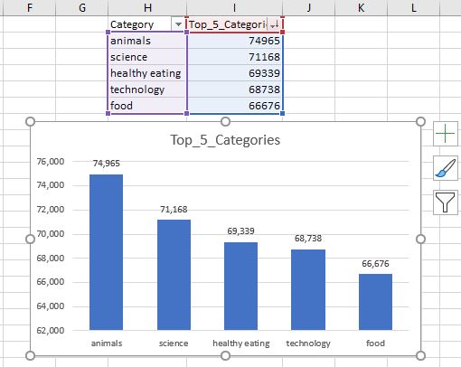

Insights

Slide 8
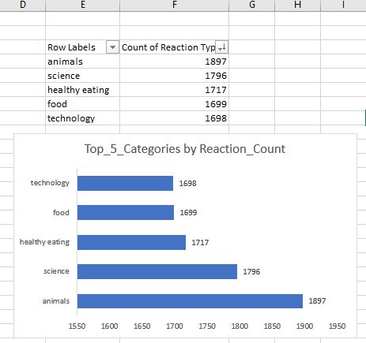

Slide 9
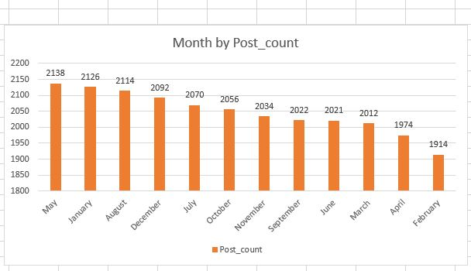

Slide 10

There is a consistent interest in lifestyle and technology-related content throughout the year, with spikes in activity in May and January.
Content related to animals, science, and healthy eating not only garners the most posts but also receives the highest engagement, highlighting their significance in the community's preferences.
Summary

Slide 11

Thank you!
ANY QUESTIONS?

